Slide 1
Bandwidth and Propagation Delay Exercises ANS
Links
Bandwidth and Propagation Delay
Pipe Diagrams
Overloaded Links
Brief Preview of the Semester
Lecture 3, Spring 2026
Notes:
so here's the outline we're going
38:16
to start by talking about links in a lot of detail think about how you measure the performance of links what makes a
38:21
link good what makes a link bad what are the trade-offs we'll talk about what happens if links get overloaded and then
38:27
the very end now that we finished all of the introduction I can actually give you a preview of all the topics you're going
38:33
to see in a lot more detail so these three sets of lectures have really been about giving you a highlevel 10,000 foot
38:39
picture of what you're going to see this semester and then at the very end I'll show you the exact places where we'll be
38:45
really diving in and talking about things in lots more detail but before we get there let's not get ahead of
38:50
ourselves let's start with talking about links and how to measure their performanc

Slide 2

Packet delay: four sources
IMPORTANT
transmission
A
propagation
The nodal processing delay (check bit errors, determine output link) is typically very small and can be ignored
B
queueing
d_{nodal} = d_{queue} + d_{trans} + d_{prop}
d_{q}: queueing delay
time waiting at output link for transmission
depends on congestion level of router
d_{tx}: transmission delay:
L: packet length (bits)
R: link transmission rate (bps)
d_{trans} = L/R
d_{prop}: propagation delay:
d: length of physical link
s: propagation speed (~2x10⁸ m/sec)
d_{prop} = d/s
Notes:
d_{proc}: nodal processing
check bit errors
determine output linknodal processing
typically < microsecs

Slide 3
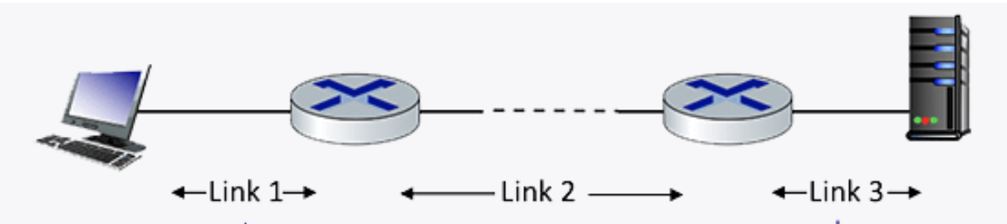
Q1 End-­to­‐end delay
Consider the network shown in the figure, with three links, each with a transmission rate of 1 Mbps, and a propagation delay of 1 msec per link. Assume the length of a packet is 1000 bits.
What is the end-end delay of a packet from when it first begins transmission on link 1, until is it received in full by the server at the end of link 3. Assume that queueing delays are zero.
Notes:
so what's going to happen is A1 and B1 both arrive we arbitrarily choose to send out A1 and
1:20:31
process it and B1 get stuck in the que how did I choose A1 over B1 open question we'll talk about it some other
1:20:37
day but for now assume that one of them was chosen and at the next time step uh oh we have some trouble A2 and B2 are
1:20:44
also arriving at the same time so the router is going to take both of them and
1:20:49
shove them in the que and in the queue they take B1 and process that one so so
1:20:55
again the exact way that the router figures out what to get queued and what to process is a bit beyond the scope for right for right now but the important
1:21:01
thing is that when packets arrive they first enter the que look A2 and B2 enter

Slide 4

Q1 End-­to­‐end delay ANS
Packet length $L=1000$bits, link rate $R=1$Mbps → transmission delay per link$t_{tx}=L/R=1000/1,000,000=0.001$s = 1ms.
Propagation delay per link $t_{prop}=$1ms.
Each link contributes $t_{tx}+t_{prop}=1+1=2$ms.
Three links → total $3×2$ms = 6ms.
Notes:
Each link has transmission delay 1000 bits/1 Mbps = 1ms. So each link has total delay of transmission + propagation = 1+1=2 ms.
For the three links, the total delay = 2 + 2 + 2 = 6 ms. `

Slide 5
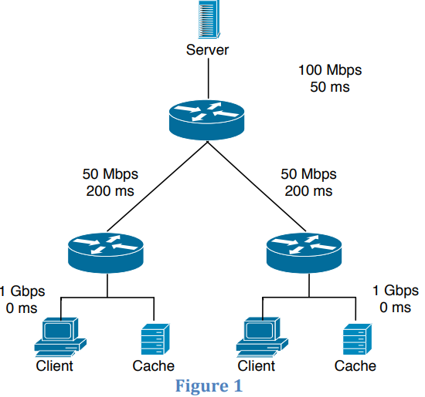
Q2 End-­to­‐end delay
Consider the scenario shown in Figure 1: a server is connected to a router by a 100Mbps link with a 50ms propagation delay. This router is connected to two other routers, each over a 50Mbps link with a 200ms propagation delay. A 1Gbps link connects each client to each of these routers with 0 propagation delay. (Ignore the cache.) All packets in the network are 20,000 bits long.
What is the end-­to­‐end delay (in ms) from when a packet is transmitted by the server to when it is received by the client? Assume there’s no queuing delay at the routers.

Slide 6
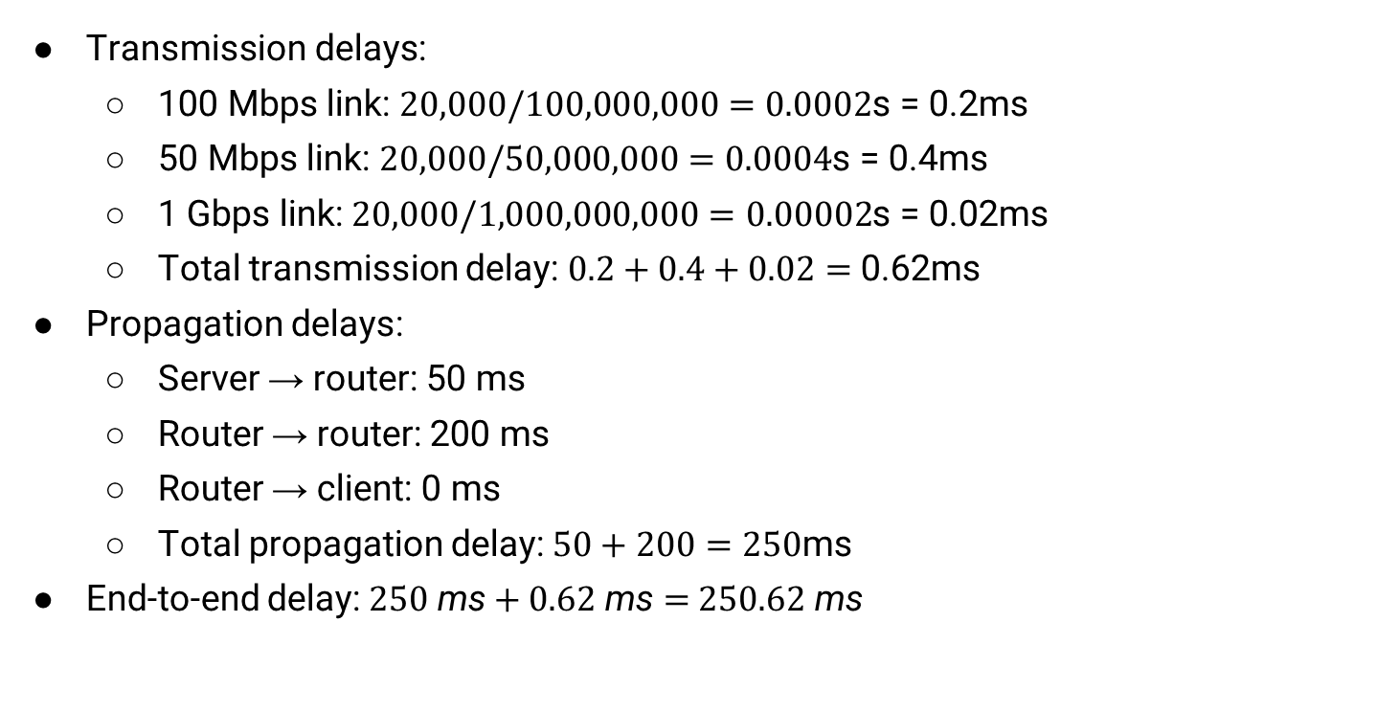
Q2 End-­to­‐end delay ANS
Transmission delays:
100 Mbps link:$20,000/100,000,000=0.0002$s = 0.2ms
50 Mbps link:$20,000/50,000,000=0.0004$s = 0.4ms
1 Gbps link:$20,000/1,000,000,000=0.00002$s = 0.02ms
Total transmission delay:$0.2+0.4+0.02=$ 0.62ms
Propagation delays:
Server → router: 50 ms
Router → router: 200 ms
Router → client: 0 ms
Total propagation delay:$50+200=250$ms
End-to-end delay:$250 \text{ms}+0.62 \text{ms}=$ $250.62 \text{ms}$
Notes:
ANS: If all packets are 20,000 bits long it takes 200 us to send the packet over the 100Mbps link, 400 usec to send over the 50Mbps link, and 20 us to send over the 1Gbps link. Sum of the three-link transmission is 620 us = 0.62 ms. Thus, the total end-to-end delay is 250 + 0.62 = 250.62 ms.
(Detailed calculations shown on the right.)

Slide 7

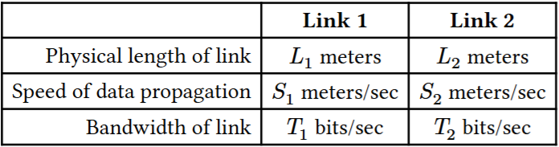
Q3.1 End-­to­‐end delay
In the diagram below, we have two different links, each with different physical properties.
Suppose 𝑇₁ = 10000, 𝐿₁ = 100000, and S₁ = 2.5 × 10⁸. How long does it take to send a 500-byte packet from Node A to Node B?

Slide 8
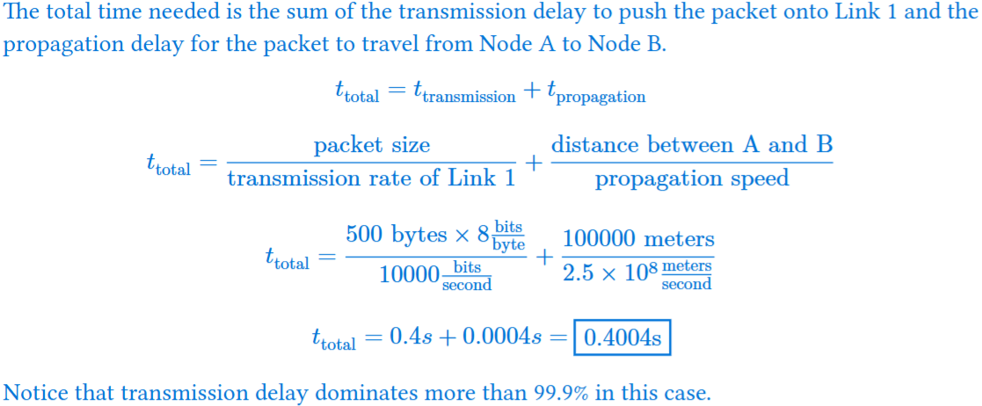
Q3.1 End-­to­‐end delay ANS

Slide 9
Q3.2 End-­to­‐end delay
The RTT (Round Trip Time) is the time it takes to send a packet (from source to destination) and receive a response (from destination to source). Count from the time the source transmits the first byte, to the time the source receives the last byte of the response.
Node A sends a 𝑥-byte packet to Node C. Then, Node C sends an 𝑥-byte response back to Node A. What is the RTT for this exchange?
Note: Since there is only one packet, there is no queuing delays. We assume processing delay is negligible, so Node C starts transmitting the response immediately after it receives the last byte of the packet.

Slide 10
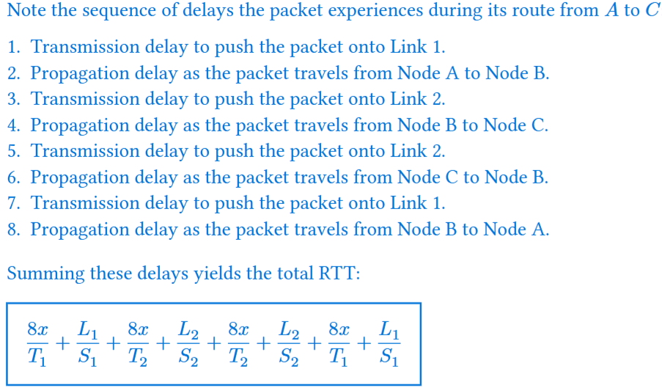
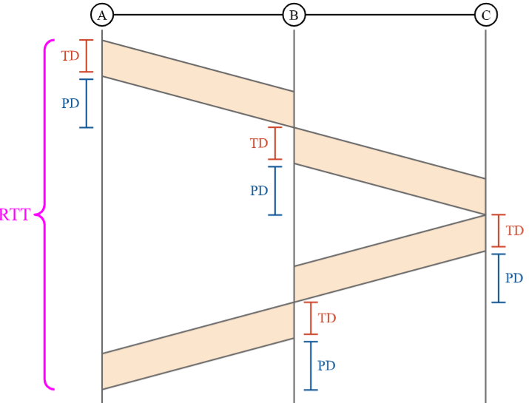
Q3.2 End-­to­‐end delay ANS
Store-and-forward: A router can start forwarding a packet only after it has received all bytes of the packet.

Slide 11
Q3.3 End-­to­‐end delay
Node A sends two packets: Packet 𝑃₁ of size 𝐷₁ bytes. Packet 𝑃₂ of size 𝐷₂ bytes. Node A starts sending packet 𝑃₁ at 𝑡 = 0. Node A immediately starts sending packet 𝑃₂ after it finishes transmitting all the bits of 𝑃₁.
When will Node C receive the last bit of packet 𝑃₂?

Slide 12
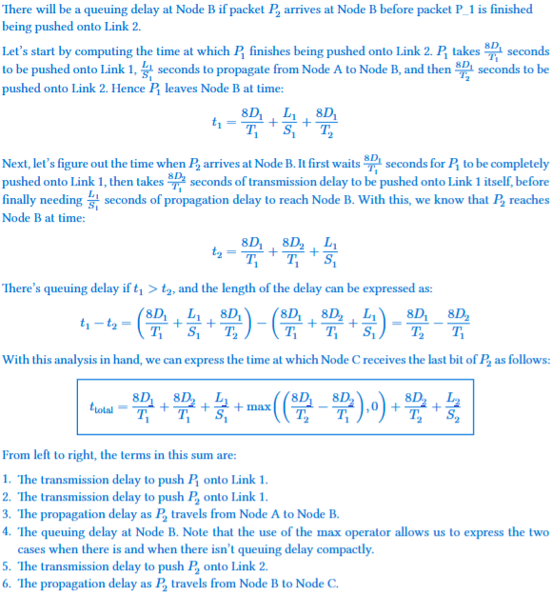
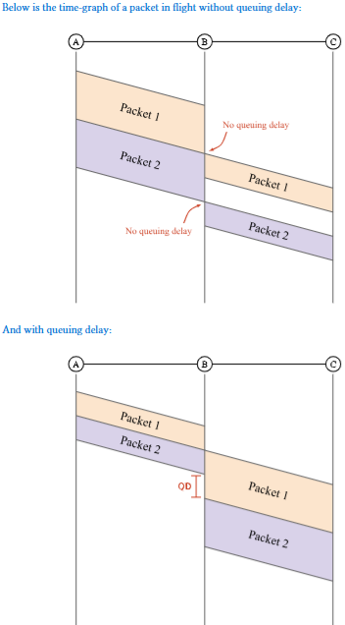
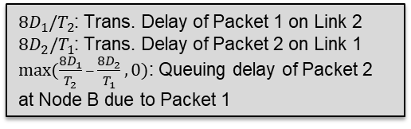
Q3.3 End-­to­‐end delay ANS
t₁: when P₁ leaves Node B
t₂: when P₂ has fully arrived at Node B, and is ready to transmitted to Node C
t₁
t₂
$8D_{1}/T_{2}$: Trans. Delay of Packet 1 on Link 2
$8D_{2}/T_{1}$: Trans. Delay of Packet 2 on Link 1
$max⁡(\frac{8D_{1}}{T_{2}}–\frac{8D_{2}}{T_{1}}, 0)$: Queuing delay of Packet 2 at Node B due to Packet 1
t₂
t₁

Slide 13
Q3.4 End-­to­‐end delay
Find the variable relations that need to be satisfied in order to have no queuing delays for part (c).

Slide 14
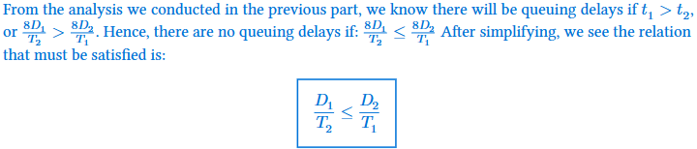
Q3.4 End-­to­‐end delay ANS

Slide 15
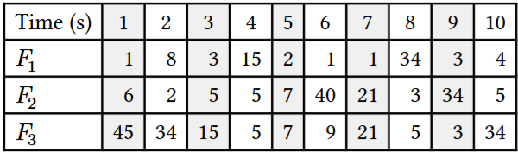
Q4. Statistical Multiplexing
Consider three flows 𝐹₁, 𝐹₂, 𝐹₃ sending packets over a single link. The sending pattern of each flow is described by how many packets it sends within each one-second interval; the table below shows these numbers for the first ten intervals. A perfectly smooth (i.e., non-bursty) flow would send the same number of packets in each interval, but our three flows are very bursty, with highly varying numbers of packets in each interval:
1) What is the peak rate of each flow? What is the sum of the peak rates?
2) Now consider all packets to be in the same aggregate flow. What is the peak rate of this aggregate flow?
3) Which is higher - the sum of the peaks, or the peak of the aggregate?

Slide 16
Q4. Statistical Multiplexing ANS
1) The peak rate is the highest the flow gets throughout the whole period. The peak rate of 𝐹₁ is 34, of 𝐹₂ is 40, and of 𝐹₃ is 45.The sum of their peaks is 34 + 40 + 45 = 119.
2) Summing the flows together column by column, we get the following values for an aggregate flow. The peak of the aggregate flow happens at 1s, where it is 52.
3) The sum of the peaks is 119, whereas the peak of the aggregate is 52, so the sum of the peaks is much higher. This is the insight from Statistical Multiplexing. The peak of the aggregate can only be at most the sum of the peaks, but that only happens in the case that all of the peaks happen at the same time. This is very unlikely, so usually, the peak of the aggregate is much lower than the sum of the peaks.

